Slide 1

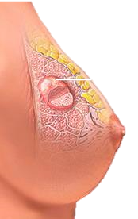
Breast Cancer
Prediction

Slide 2
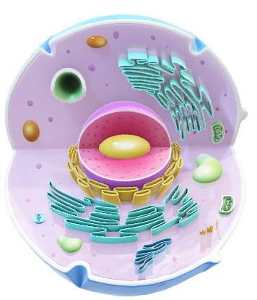
‘M’
Malignant
DATASET
DESCRIPTION
Benign
‘B’
Dataset Description
Real Valued Features of Nucleus
ID Number
Diagnosis
Radius
Texture
Perimeter
Area
Smoothness
Compactness
Concave points
Symmetry
Fractal dimension
Fractal geometry

Slide 3
Checked for missing values
Converted diagnosis to binary
Checked for duplicate rows
33
Number of Columns
3
Column Categories
10
No. features each
Mean
Std. Error
Worst Values
Data examination
Data cleaning

Slide 4
Checked for missing values
Converted diagnosis column to binary
Checked for duplicate rows
33
Number of Columns
3
Column Categories
10
No. features each
Mean
Std. Error
Worst Values
Data examination
Data cleaning

Slide 5
Correlation Between
Diagnosis and Variables
100th
75th
PERCENTILE
25th
0th
Radius
Texture
Perimeter
Area
Smooth
Compact
Con Points
Symmetry
Frac dim
Frac geo

Slide 6
Training Models
Logistic Regression (0.97)
Support Vector Machine (0.96)
Gradient Boosting Classifier (0.96)
Artificial Neural Network (0.96)
Random forest (0.95)
K-Nearest Neighbors (0.95)
Naïve Bayes (0.95)
Decision Tree (0.95)
Logistic Regression
97%
Accuracy

Slide 7





TEAM
SOS Pi Group 4

Slide 8




TEAM
MAVIS

Slide 9
Thank you!
SOS Pi Group 4

Slide 10
